Slide 1

Internship Project GPS Tracker
General Presentation
Goals & Current Progression

Slide 2
Functionality
This project aims to build a portable and battery efficient GPS tracker that sends out its location through a GSM or GPRS interface, thus being able to send the GPS coordinates of its location to the user either by SMS or by updating a web-rendered map.
This module will have 2 functioning states: SLEEP mode in which the GPS tracker will aim to consume the least amount of power as possible. This state is useful for when the tracker remains still for extended periods of time. The other state, GET_GPS, is being used when the module is in motion and will send its GPS coordinates to the user.

Slide 3
Modules used
The GPS tracker will be built around these three main modules:
I: MCHP AVR128DA48 μController- main processing unit which communicates with the other modules and controls them.
II: SIMCOM SIM808 GSM/GPRS+GPS module – the main communication interface with the outside world, being able to extract its exact GPS coordinates and access GSM/GPRS networks using a SIM card.
III: BOSCH BMI160 accelerometer – this module can sense sudden movements, thus alerting the μC when the tracker is being moved. We are allowing the tracker to remain in its lowest power consumption mode while it is not moving.

Slide 4
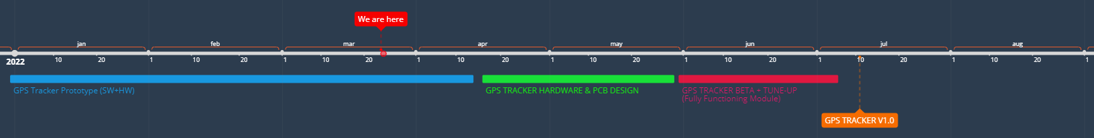
Project Timeline
GPS TRACKER PROTOTYPE: In this stage of the project we will sacrifice the aspect of portability and power efficiency in hopes of a faster development. We will use the available shields for each module for their quick plug-and-play capabilities(AVR CURIOSITY NANO+CURIOSITY NANO ADAPTER for the AVR128DA48 microcontroller, 6DOF IMU 2click shield for the BMI160 and a standard shield for the SIM808 module).
This is the stage where the project is currently at.

Slide 5
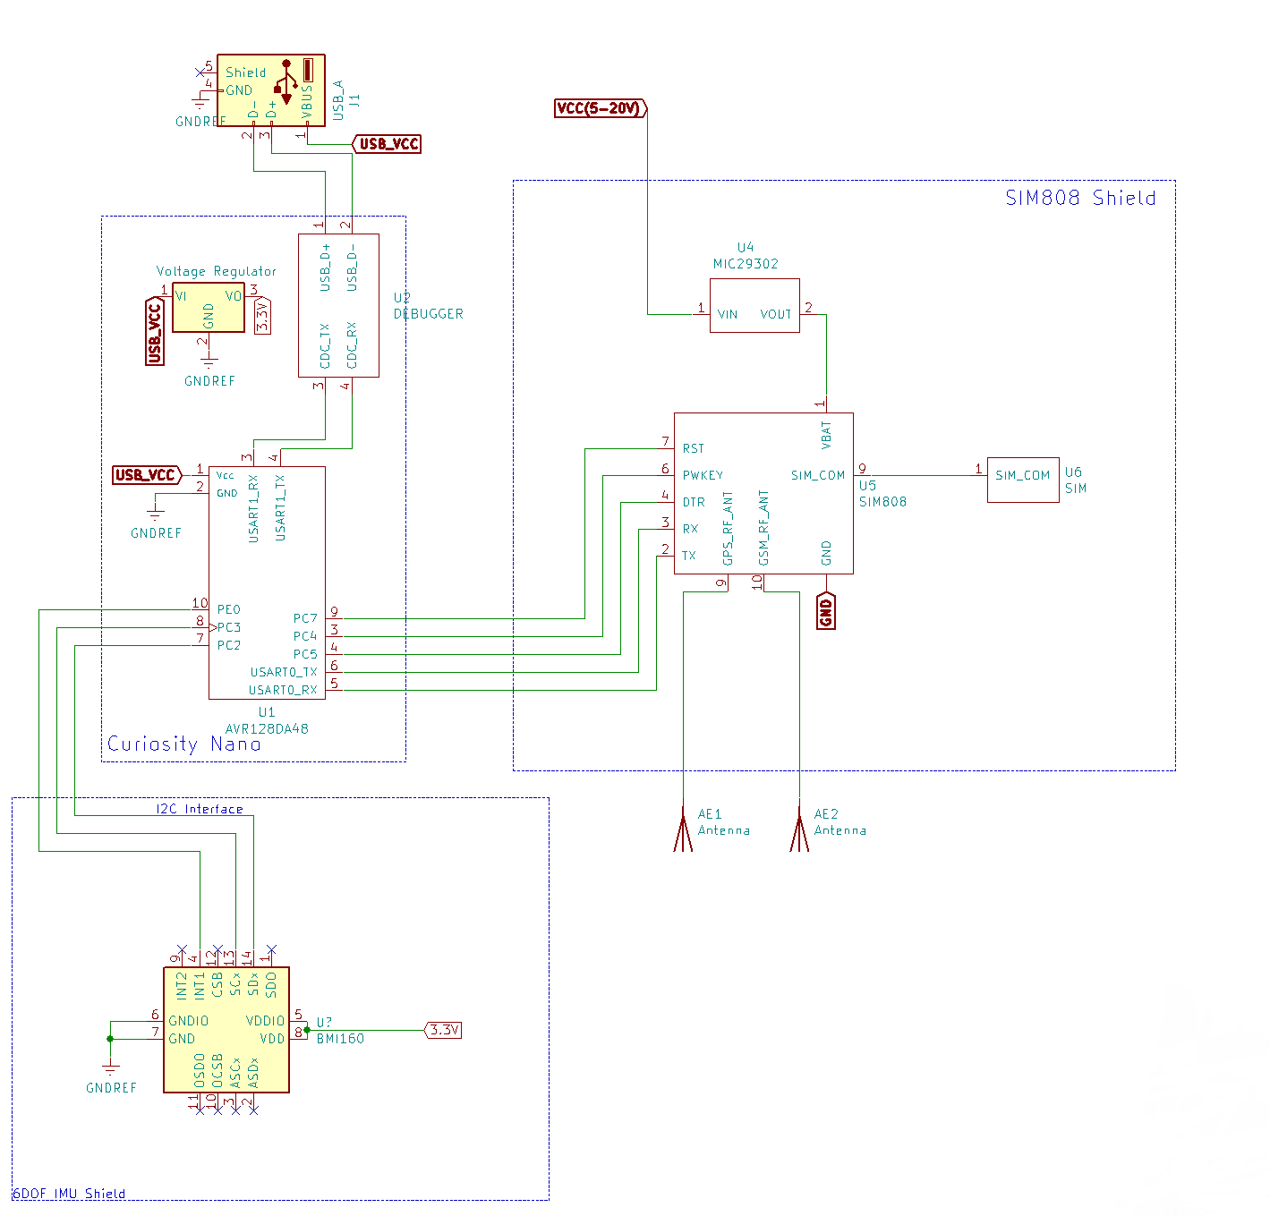
GPS TRACKER HW PROTOTYPE BLOCK SCHEMATIC
Connections made between the 3 shields.

Slide 6
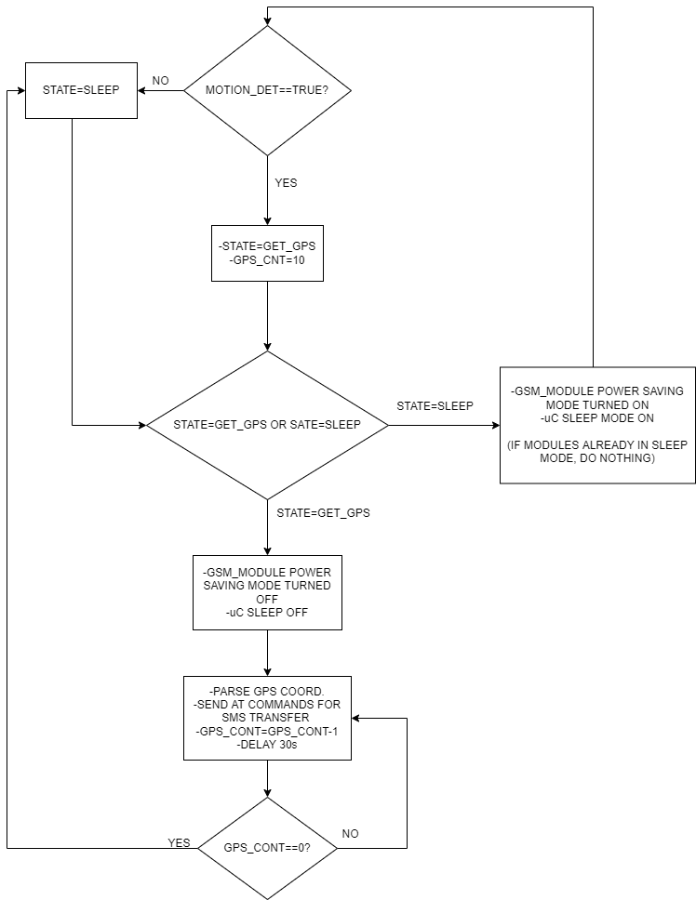
Software Architecture Prototype
Flowchart diagram of the software architecture loaded on the microcontroller

Slide 7
Next goals for GPS TRACKER PROTOTYPE stage
Fully integrate GPRS communication (currently main communication is made through GSM with SMS text messages)
Achieve full communication with a web-site that will store the current and previous GPS coordinates into a database.
Improve readability of the software.

Slide 8
Goals for the next project stages
GPS TRACKER HW and PCB design
Achieve better power efficiency by stripping out unnecessary components.
Integrate battery charging functionality
Build a compact and portable PCB board
GPS TRACKER BETA+TUNE UP
Improve software efficiency
Fix any software bugs or hardware errors
Build a user-friendly GUI for the web-site (can be done later)

Slide 9

Thank You!
https://bitbucket.microchip.com/projects/MCU8NPIAPPS/repos/gsm_tracker_internship/browse

